Slide 1
Driver Onboarding Service By: Hukam Singh
Intuit Craft Demonstration

Slide 2
About Me
CSE graduate (2015) from JIIT, Noida
Working as SDE2 at Olx
Working experience of 8+ years in Java, Spring Boot, Microservices.

Slide 3
Driver Onboarding Service Features
Register a driver, capturing all the necessary details to create a driver profile.
Collect necessary documents for verification.
Allow verification of uploaded documents from backend.
User can download uploaded documents.
User can see the status of the application.
User can log out of the application.
On new login, earlier login access is revoked.

Slide 4
Assumptions
3rd party application is responsible for background verification.
Driver is registering as a driver only. Driver with a vehicle owner integration is out of scope.
Document-type should be structured from frontend side and based on region it may vary. No validation at document type. User may be able to upload document only with document type and it will be mandatory to upload all the document type which was configured from frontend to go into document verification stage.
Document Verification Engine initiates the background verification process.
Role based authentication is currently out of scope
No Rate limiters/ Circuit Breakers, retries are implemented yet.

Slide 5
Tech Stacks Used
Java
Spring Boot
MySQL Server
Apache Kafka
MongoDB Server

Slide 6
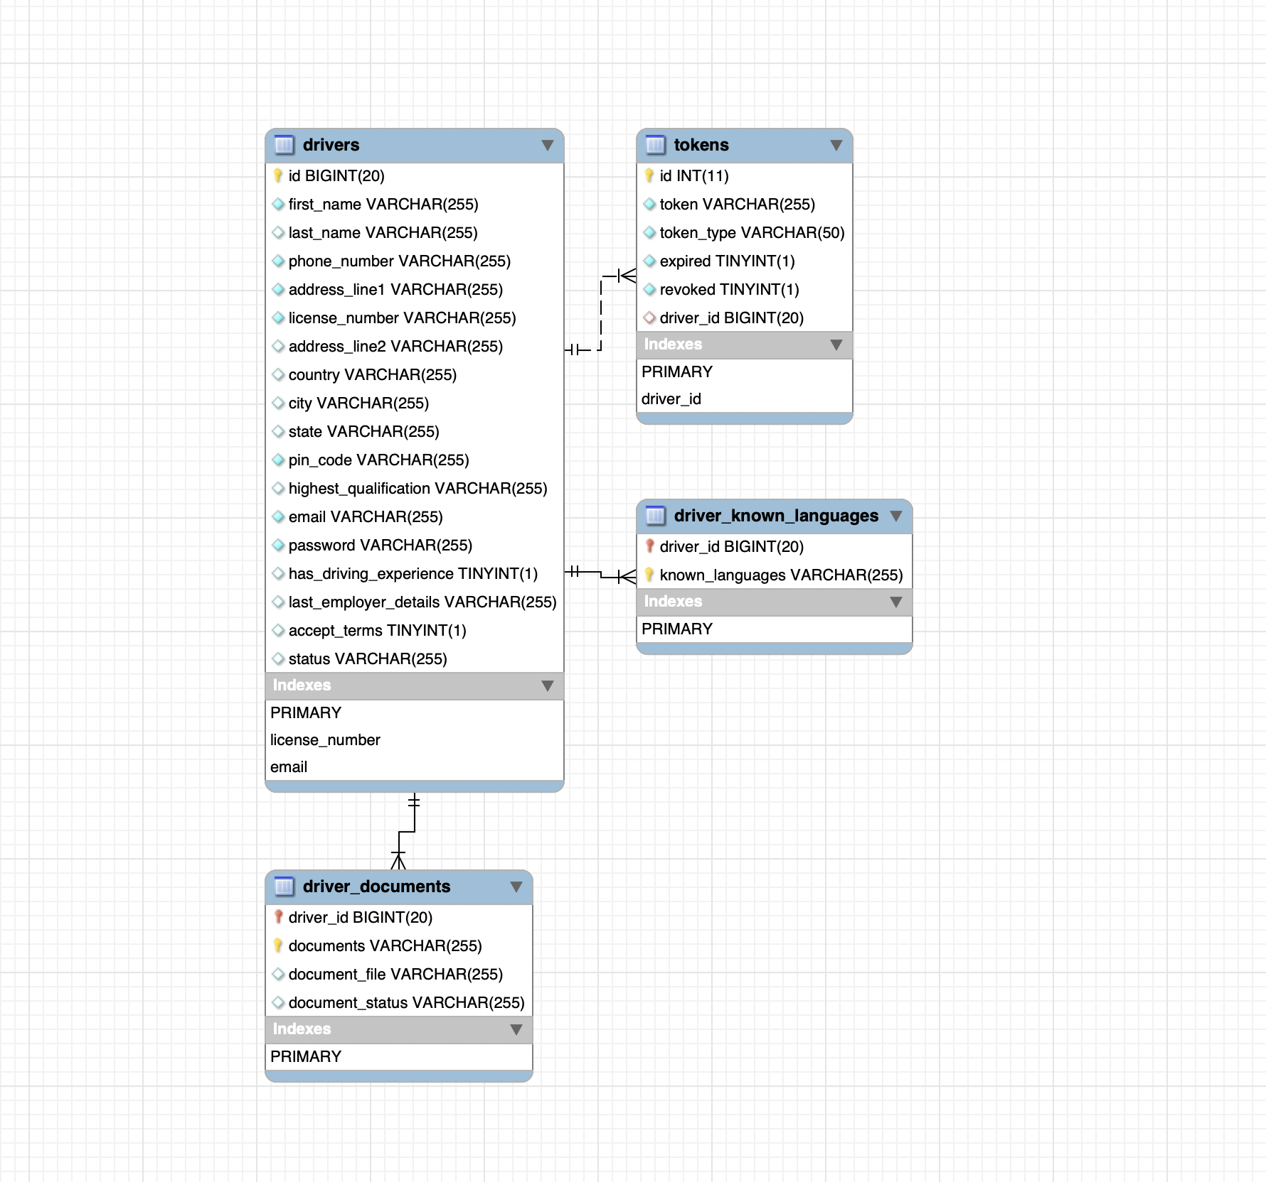
ER diagram

Slide 7
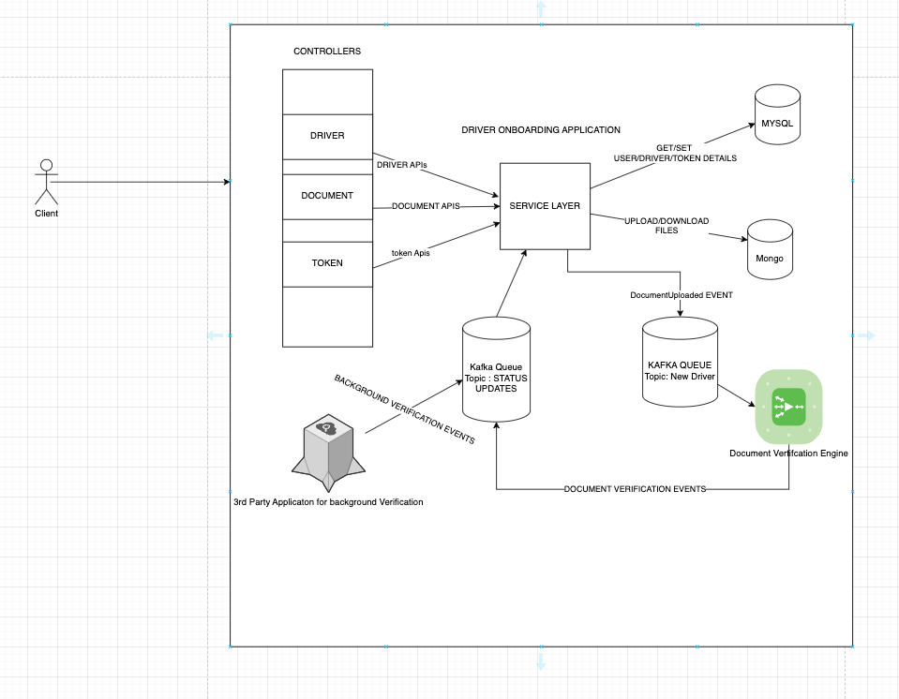
DESIGN

Slide 8
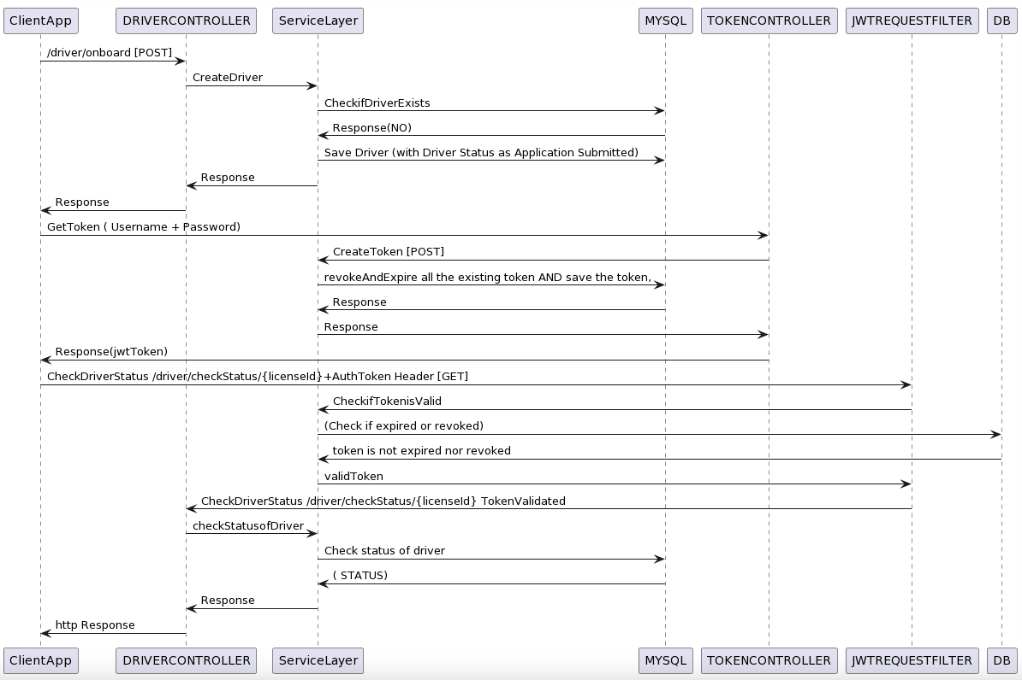
Sequence Diagram 1[DRIVER]

Slide 9
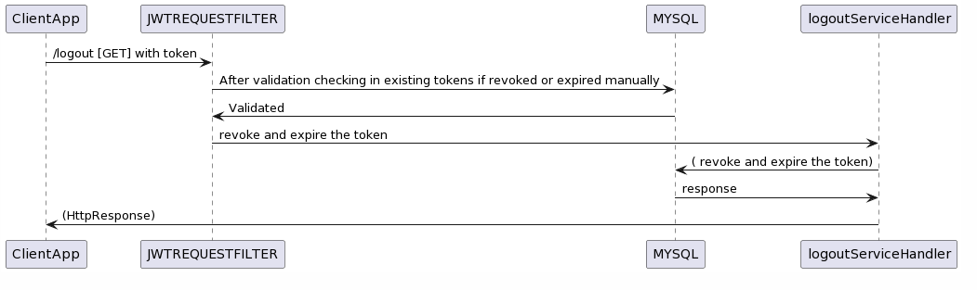
Sequence Diagram 2[TOKEN]

Slide 10
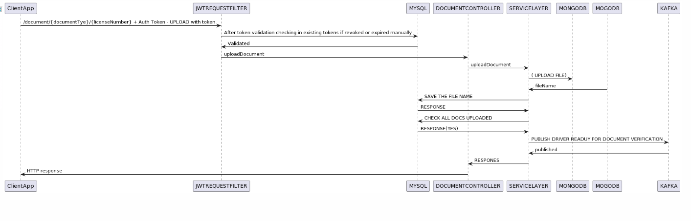
Sequence Diagram 3[DOCUMENT]

Slide 11
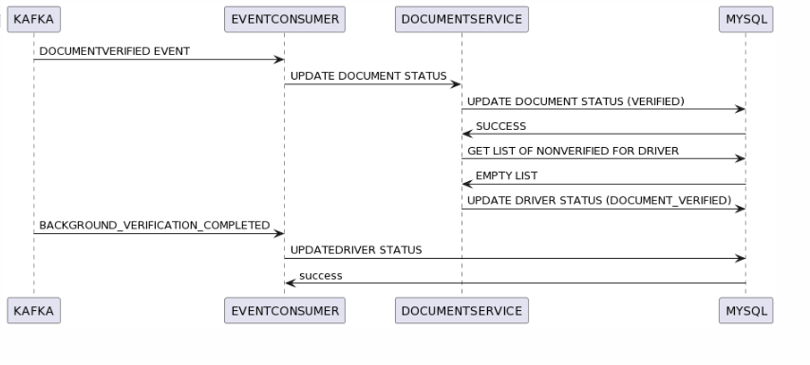
Sequence Diagram 4[EVENTS]

Slide 12
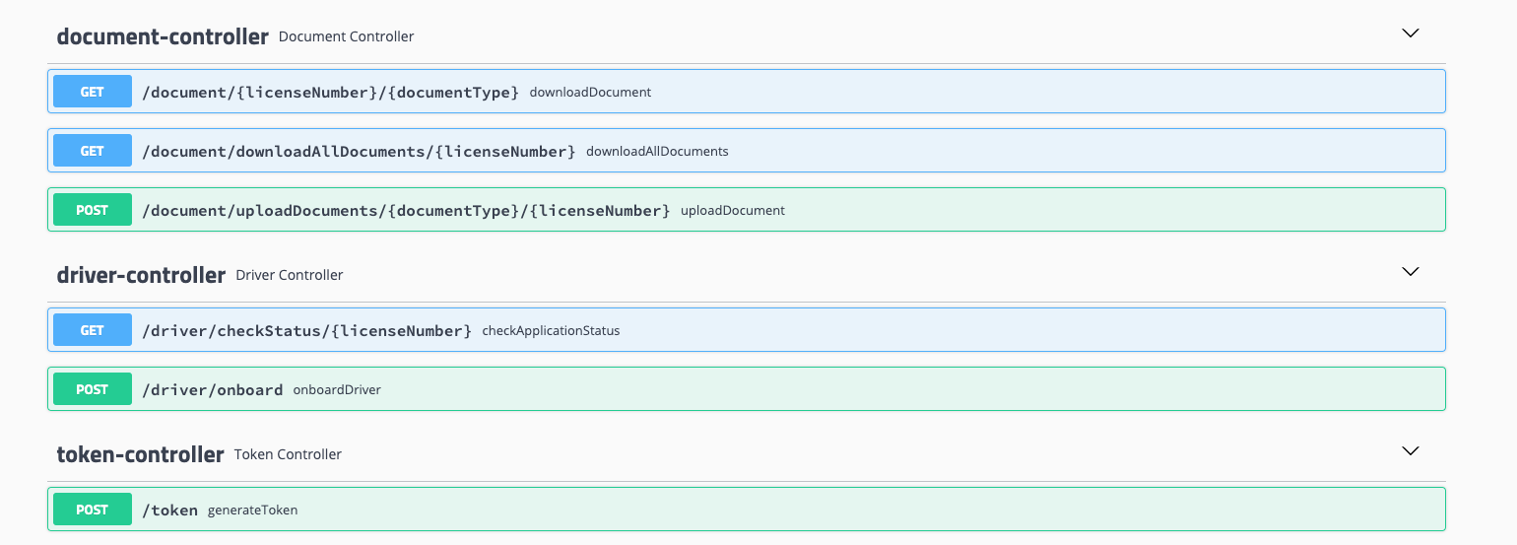
API Exposed

Slide 13
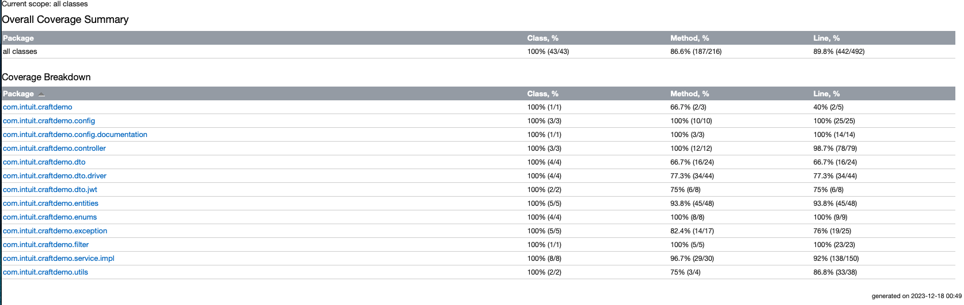
Test Coverage

Slide 14
Future Scope
Handle Failures for Event ( if a event was failed in between or was not even sent)
Monitoring/Logging centralised
Admin access and UI
User role based authentication(RBAC)
Rate limiters/ Circuit Breakers, retries
MFA(multi-factor Authentication , OTP based)
Multi language support(Internationalisation)
Vehicle integration, vehicle inspection, quality check, RC validation, permit validations

Slide 15
Thankyou

